Slide 1

Introduction to Data Visualization Tools

Slide 2
Objectives
Read csv files into a Pandas DataFrame
Process and manipulate the data in the DataFrame
Generate line plots using Matplotlib
Data Visualization Tools

Slide 3
Dataset overview
The population division of the United Nations compiled immigration data pertaining to 45 countries.
The data consist of the total number of immigrants from all over the world to each of the 45 countries as well as other metadata pertaining to the immigrants countries of origin.
We will focus on immigration to Canada and we will work primarily with the data set involving immigration to the great white north
Data Visualization Tools

Slide 4
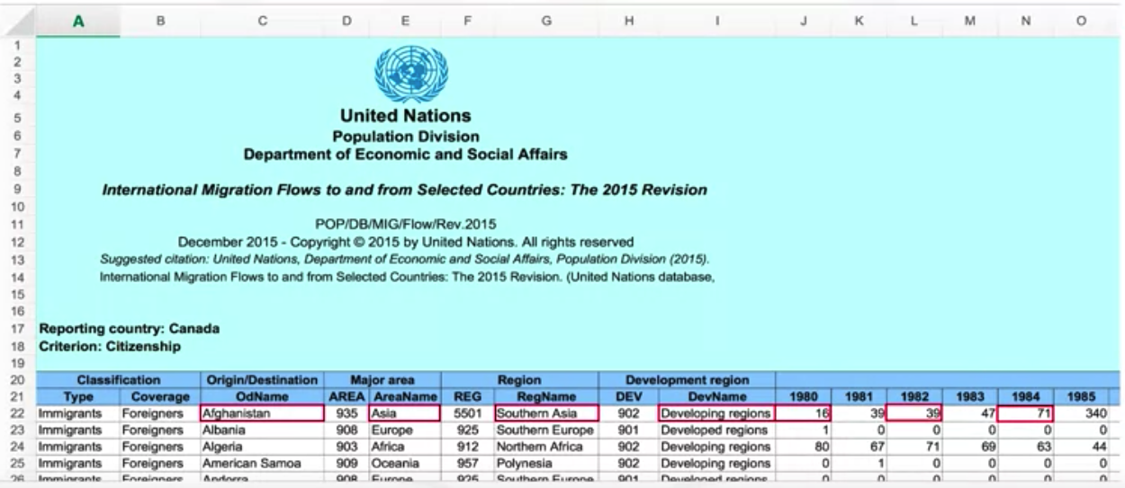
Immigration Data to Canada
The first twenty rows contain textual data about the UN Department and other irrelevant information.
Row 21 contains the labels of the columns.
Each row also contains the total number of immigrants from that country for the years 1980 all the way to 2013.
Data Visualization Tools
Notes:
https://cf-courses-data.s3.us.cloud-object-storage.appdomain.cloud/IBMDeveloperSkillsNetwork-DV0101EN-SkillsNetwork/Data%20Files/Canada.xlsx

Slide 5
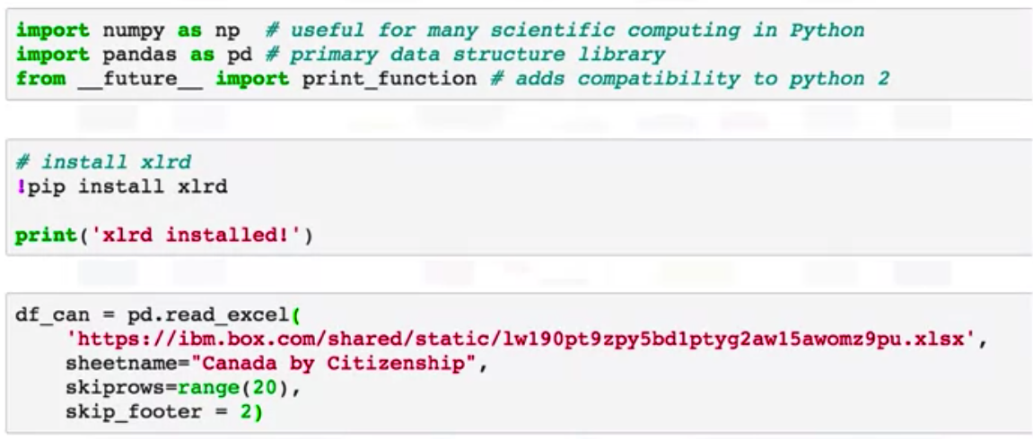
Read data
Try the code and show the results
Data Visualization Tools
Notes:
Dataset online

Slide 6
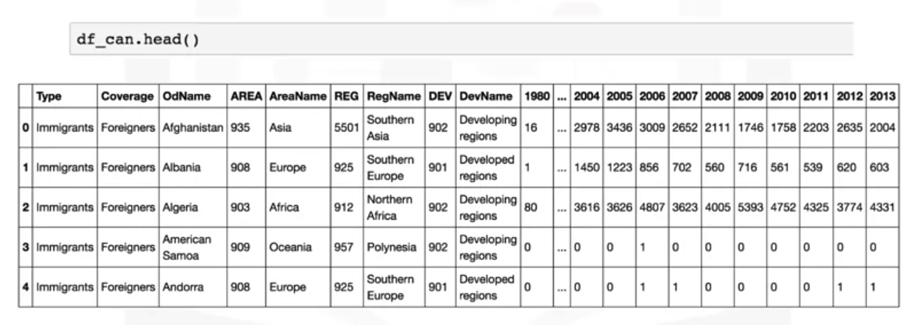
Display DataFrame
Topic11111
Data Visualization Tools

Slide 7
Line Plots
What is a line plot?
  It is a plot in the form of a series of data points connected by straight-line segments.
  It is one of the most basic types of charts and is common in many fields, not just data science.
When do we use line plots?
  When you have a continuous dataset and you're interested in visualizing the data over a period of time.
Based on the Migration data set --> student give an example!
Data Visualization Tools

Slide 8
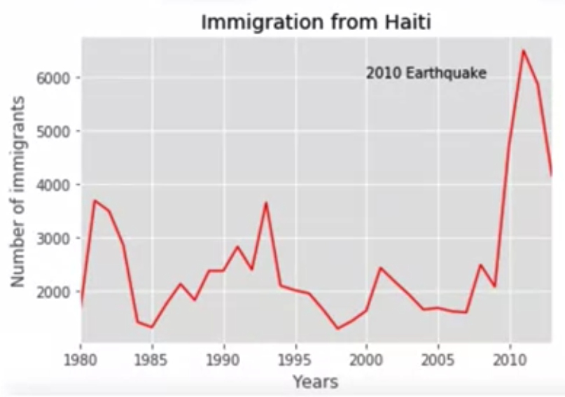
Line Plots
The trend of Haitian immigrants to Canada from 1980 to 2013.
What is the obvious anomalies or changes?
Hint: Google search with keyword: Haiti 2010
Data Visualization Tools
Notes:
we see that there is a spike of immigration from Haiti to Canada in 2010. A quick Google search for major events in Haiti in 2010 would return the tragic earthquake that took place in 2010, and therefore this influx of immigration to Canada was mainly due to that tragic earthquake.

Slide 9
Line Plots
Immigration data
  Each row represents a country and contains metadata about the country
  Each row also contains numerical figures of annual immigration from that country to Canada from 1980 to 2013.
Processed dataset
  The country name becomes the index of each row.
  Add an extra column that represents the cumulative sum of annual immigration from each country from 1980 to 2013.
Data Visualization Tools

Slide 10
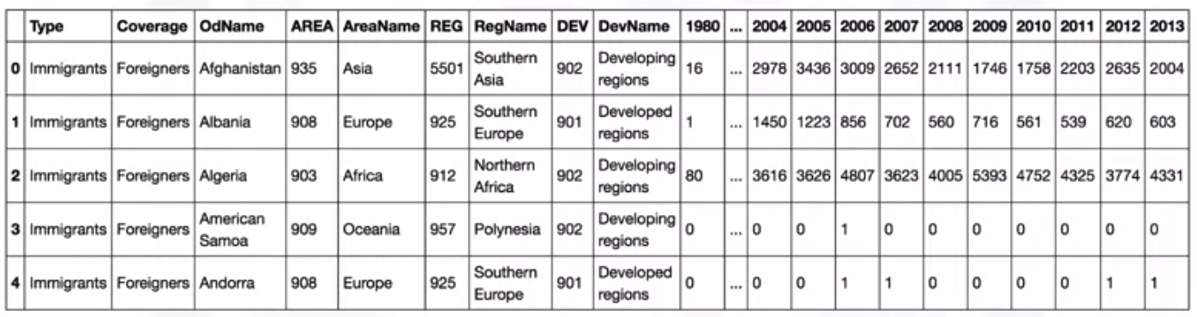
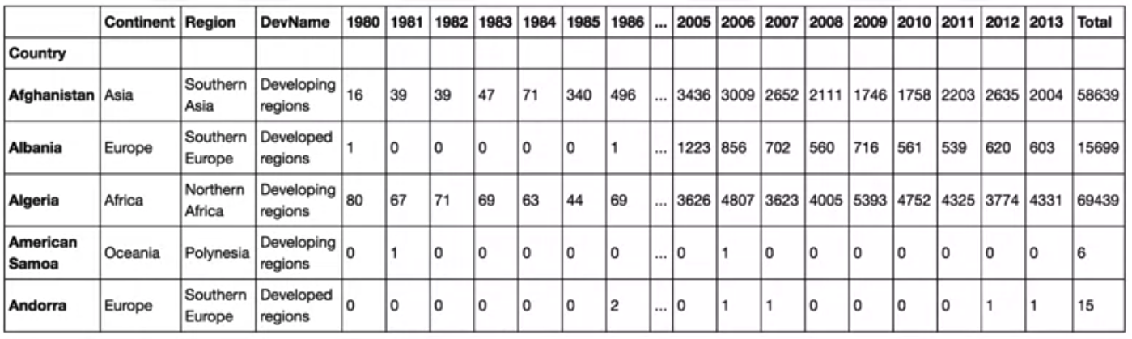
Line Plots
Data Visualization Tools

Slide 11
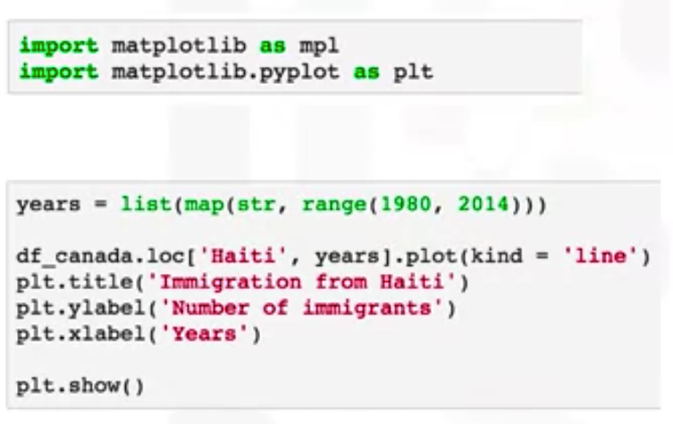
Line Plots
Try this code and show the results
Data Visualization Tools

Slide 12
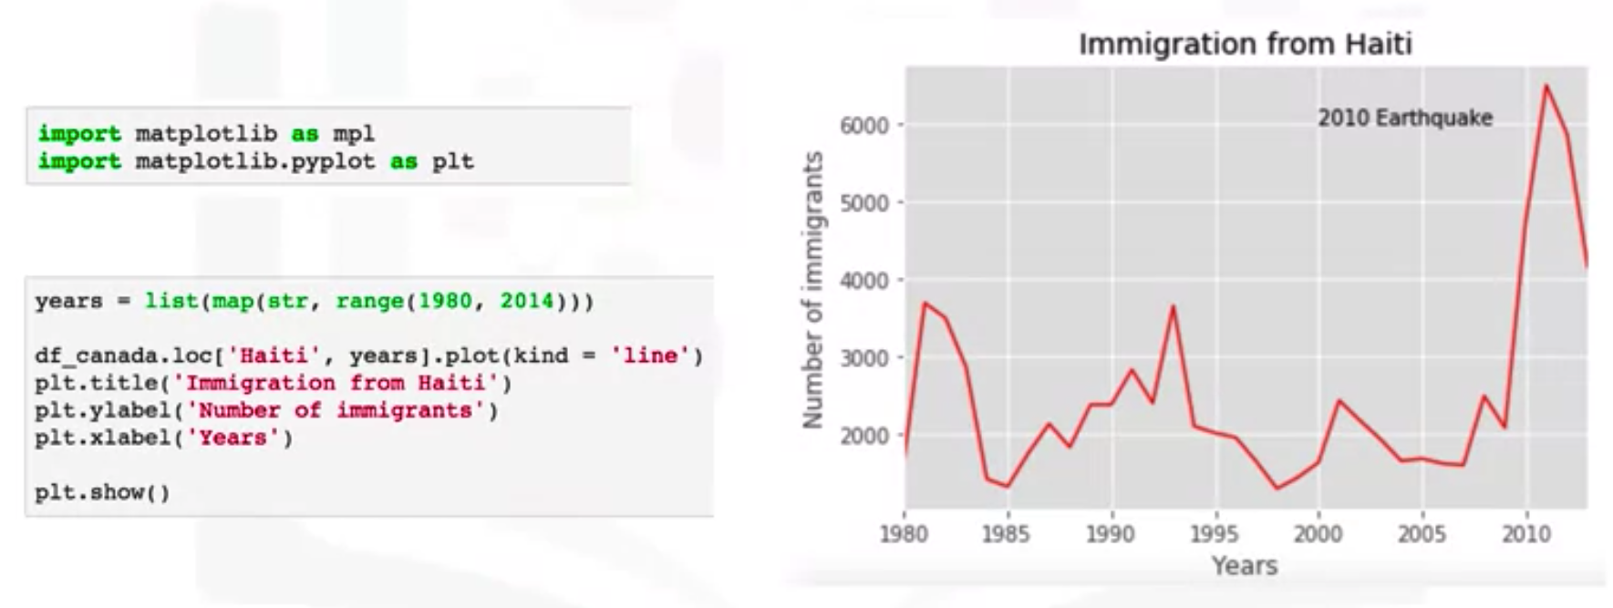
Line Plots
Create line Plots
Data Visualization Tools

Slide 13
Summary
Read csv files into a Pandas DataFrame
Process and manipulate the data in the DataFrame
Generate line plots using Matplotlib
Data Visualization Tools

Slide 14
Q & A
Data Visualization Tools

